Slide 1
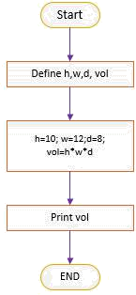
LAB :1
Objective(s):
To be familiar with syntax and structure of C- programming. To learn problem-solving techniques using C
Program: Write a Program to calculate and display the volume of a CUBE having its height (h=10cm), width (w=12cm) and depth (8cm).
Algorithm:
Start
Define variables: h(int), w(int), d(int), vol(int)
Assign value to variables: h = 10, w=12, d=8
Calculate the volume as: vol = h*w*d
Display the volume (vol)
Stop
Flowchart:

Slide 2

Code: (Use comments wherever applicable)
#include<stdio.h> void main()
{
//start the program
int h,w,d,vol; //variables declaration h=10;w=12;d=8; //assign value to variables
vol=h*w*d; //calculation using mathematical formula printf("The Volume of the cube is: %d",vol); //display the volume
getch();
//end the main program
}
Output :
The Volume of the cube is: 960
SAMPLE PROGRAMS
(Students are to code the following programs in the lab and show the output to instructor/course teacher)
Instructions
Write comment to make your programs readable.
Use descriptive variables in your programs(Name of the variables should show their purposes)
Programs List
Write a C program to display “This is my first C Program”.
Write a C program to add two numbers (2 and 6) and display its sum.
Write a C program to multiply two numbers (4 and 5) and display its product.
Write a C program to calculate area and circumference of a circle.
Write a C program to perform addition, subtraction, division and multiplication of two numbers.
Write C program to evaluate each of the following equations.
  V = u + at. (ii) S = ut+1/2a (iii) T=2*a+√b+9c
Write a program that reads an employee's number, his/her worked hours number in a month and the amount he received per hour. Print the employee's number and salary that he/she will receive at end of the month, with two decimal places.

Slide 3
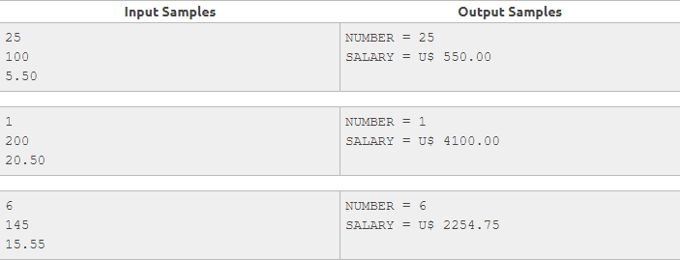
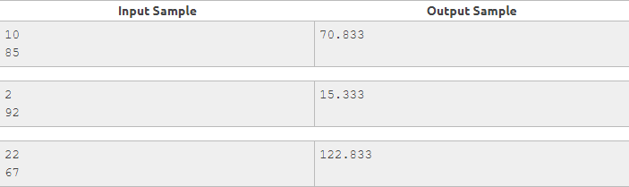
8. Little John wants to calculate and show the amount of spent fuel liters on a trip, using a car that does 12 Km/L. For this, he would like you to help him through a simple program. To perform the calculation, you have to read spent time (in hours) and the same average speed (km/h). In this way, you can get distance and then, calculate how many liters would be needed. Show the value with three decimal places after the point.

